Slide 1

FOUNDATION MATHEMATICS II
By: Rodgers Kimera
A Regional University Transcending Boundaries

Slide 2

Functions

Slide 3










Objectives
After studying this topic, you should;
understand what is meant by a function;
be able to understand the different types of functions
be able to solve the different types of functions
Understand exponential functions
Understand logarithmic functions
Understand hyperbolic functions

Slide 4
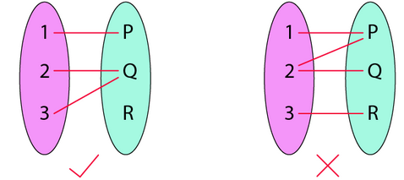













Introduction
A function is a relation between a set of inputs and a set of permissible outputs with the property that each input is related to exactly one output.
Let A & B be any two non-empty sets; mapping from A to B will be a function only when every element in set A has one end and only one image in set B.

Slide 5

















Slide 6






























Slide 7

































Slide 8

Cont …
Another definition of functions is that it is a relation “f” in which each element of set “A” is mapped with only one element belonging to set “B”.
Also, in a function, there can’t be two pairs with the same first element.

Slide 9














Condition for a Function
Set A and Set B should be non-empty.
In a function, a particular input is given to get a particular output. So, a function f: A->B denotes that f is a function from A to B, where A is a domain, and B is a co-domain.
For an element, a, which belongs to A, a ∈ A, a unique element b, b ∈ B is there such that (a,b) ∈ f.
The unique element b to which f relates a is denoted by f(a) and is called f of a, or the value of f at a, or the image of a under f.
The range of f (image of a under f)
It is the set of all values of f(x) taken together.
Range of f = { y ∈ Y | y = f (x), for some x in X}

Slide 10
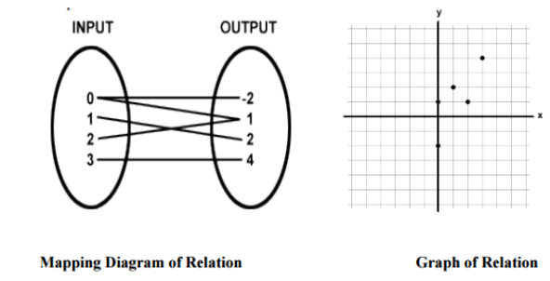

Relation
A relation is a set of inputs and outputs, often written as ordered pairs (input, output) for (x, y). We can also
represent a relation as a mapping diagram or a graph. For example, the relation can be represented as:
A function is a relation in which each input x (also called the domain) has ONLY ONE output y (also called the range).

Slide 11
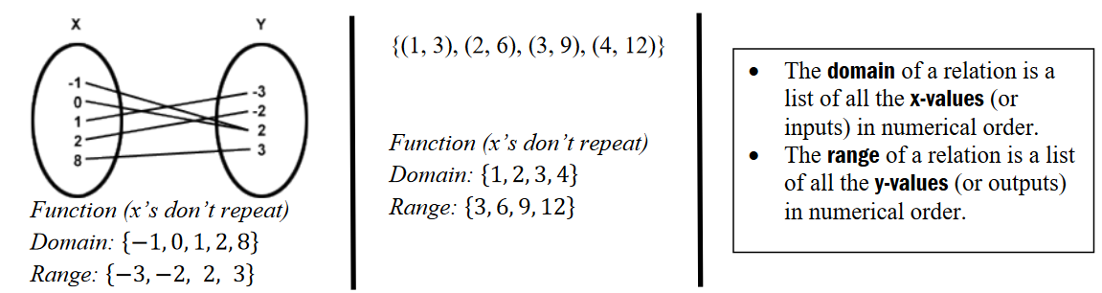





More on Functions
A relation is a set of inputs and outputs, often written as ordered pairs (input, output) for (x, y). We can also
represent a relation as a mapping diagram or a graph. For example, the relation can be represented as:
A function is a relation in which each input x (also called the domain) has ONLY ONE output y (also called the range).

Slide 12







Representation of Functions
Functions are generally represented as f(x).
Let , f(x) = x^3.
It is said as f of x is equal to x cube.
Functions can also be represented by g(), t(),… etc.

Slide 13




Steps for Solving Functions
Question:
Find the output of the function g(t) = 6t^2 + 5 at
(i) t = 0
(ii) t = 2
Solution:
The given function is g(t) = 6t^2 + 5
(i) At t = 0, g(0) = 6(0)2 + 5 = 5
(ii) At t = 2, g(2) = 6(2)2 + 5 = 29

Slide 14













Slide 15



















Slide 16























Slide 17























Slide 18
















Slide 19


































Slide 20




















Slide 21







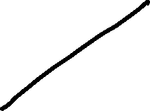




















Slide 22







Slide 23































Slide 24




















Slide 25





















Slide 26













Slide 27
















Slide 28





















Slide 29






















Slide 30




















Slide 31
































Slide 32

























Slide 33





























Slide 34








Types of Functions
There are various types of functions in Mathematics which are explained below in detail. The different function types covered here are given below:
One-one Function
Many-one Function
Onto Function
Into Function
Polynomial Function
Linear Function
Identical Function
Quadratic Function
Rational Function
Algebraic Functions
Cubic Function
Modulus Function
Signum Function
Greatest Integer Function
Fractional Part Function
Even and Odd Function
Periodic Function
Composite Function
Constant Function
Identity Function

Slide 35



































Slide 36
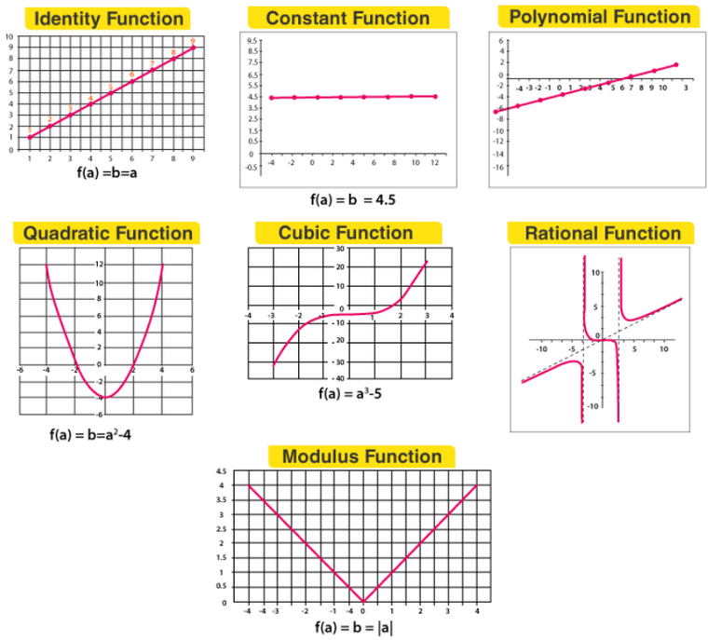
Example plots of functions

Slide 37
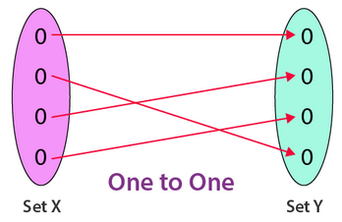
One-one Functions
If each element in the domain of a function has a distinct image in the co-domain, the function is said to be a one-one function.
For example, f; R R, given by f(x) = 3x + 5, is one-one.

Slide 38
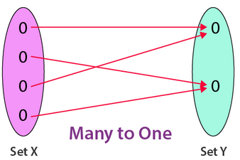
Many-one function
On the other hand, if there are at least two elements in the domain whose images are the same, the function is known as many to one.
For example, f : R R, given by f(x) = x2 + 1, is many-one.

Slide 39
Polynomial function
A real-valued function f : P → P defined by
N = a non-negative integer.
The degree of the polynomial function is the highest power in the expression.
If the degree is zero, it’s called a constant function.
If the degree is one, it’s called a linear function. For example, b = a+1.

Slide 40
Polynomial function
The highest power in the expression is known as the degree of the polynomial function. The different types of polynomial functions based on the degree are as follows:
The polynomial function is called a constant function if the degree is zero.
The polynomial function is called a linear if the degree is one.
The polynomial function is quadratic if the degree is two.
The polynomial function is cubic if the degree is three.

Slide 41
Variations of Polynomial function
Remember the following in Foundation Mathematics 1
Linear functions
Quadratic equations
Cubic Equations

Slide 42
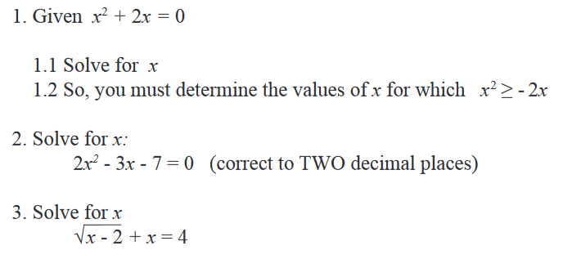
Check Point

Slide 43
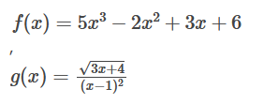
Algebraic function
An algebraic equation is known as a function that consists of a finite number of terms involving powers and roots of independent variable x and fundamental operations, such as addition, subtraction, multiplication and division.
For example,

Slide 44
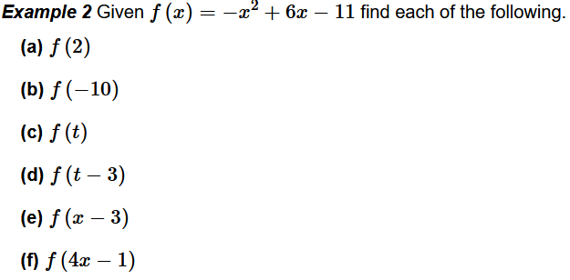
Check Point

Slide 45



Check Point

Slide 46
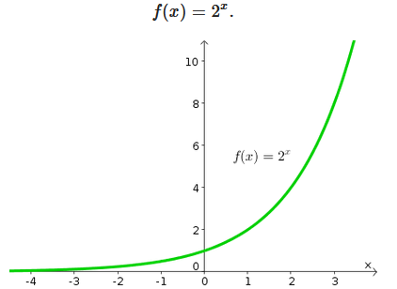
Exponential Functions
One of the most important functions in mathematics
To form an exponential function, we let the independent variable be the exponent. A simple example is the function

Slide 47
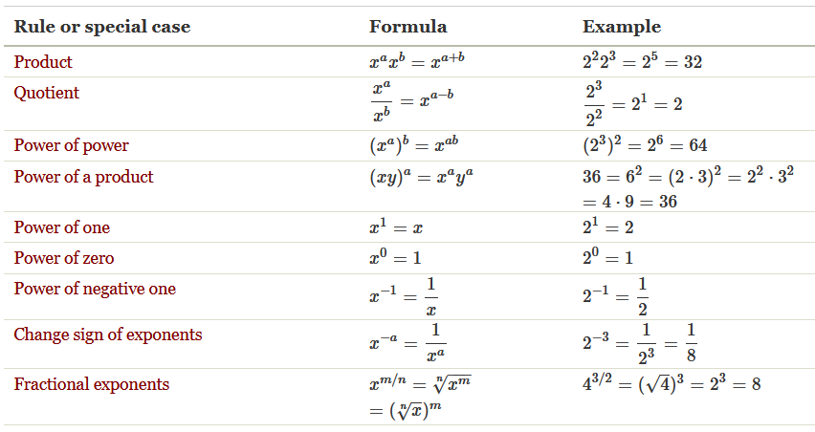
Basic rules for exponentiation
Below are some of the rules that govern exponentiation

Slide 48
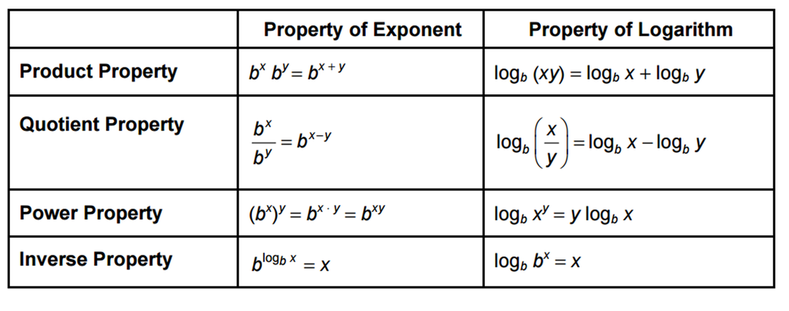
Logarithmic Functions
Logarithmic functions are the inverses of exponential functions, and any exponential function can be expressed in logarithmic form.
Similarly, all logarithmic functions can be rewritten in exponential form. Logarithms are useful in permitting us to work with very large numbers while manipulating numbers of a much more manageable size.

Slide 49
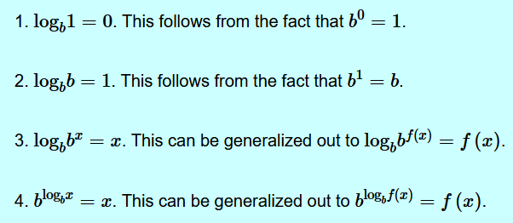
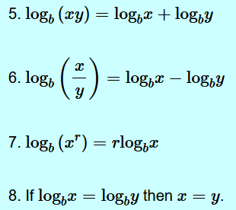
Properties of Logarithms

Slide 50
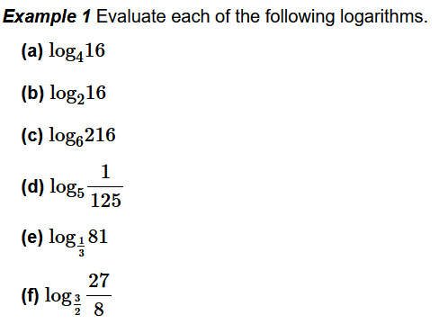
Check Point 1

Slide 51
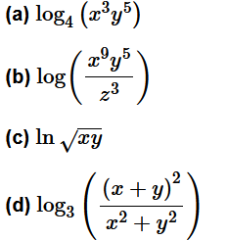
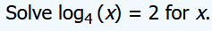



Check Point 2
Simplify each of the following logarithms.

Slide 52
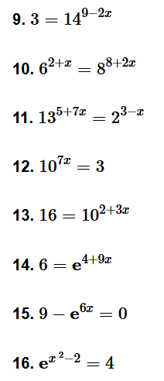
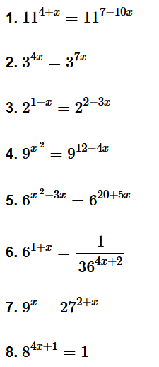
Solving Exponential Equations – Assignment Problems

Slide 53
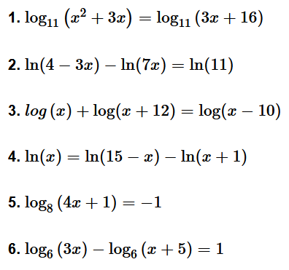
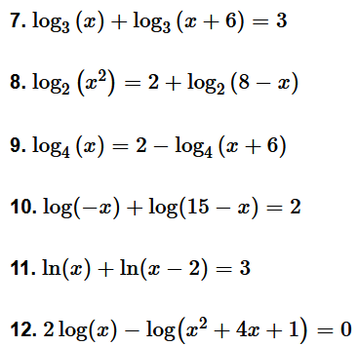
Solving Logarithmic Equations – Assignment Problems

Slide 54
THE END
Thanks for listening

